Slide 1
PYTHON

Slide 2





I. PRIMITIVE DATA TYPE
FEW CONCEPTS:
Variable is used to store value.
Single equal sign (=) is used for assignment. When you write x = 1 , this mean you assign the value of 1 to variable x. Now x is 1.
WARNING! Ensure to differentiate between String and Variable.
e.g.
Printing “iAm” will produce the text(string) “iAm” as the quotation mark denotes a string. While printing the variable iAm, will give the value of the variable.
1. Numbers - Digits, including decimal.
2. Booleans - True / False
3. Strings - Text
4. None – absence of value
https://www.w3schools.com/python/python_datatypes.asp
x = 2 | z = 0 | d = 1.2
y = -1 | a = x + y | e = -0.1
x = True | x and y
y = False | x or y
x = "double quote string" | z = ‘’’multi line using triple single quote’’’
y = ‘single quote string’
x = None

Slide 3
PRIMITIVE DATA TYPE - Exercise
Assign 10 to x , 2 to y . Multiply x and y , then assign it to z. Print z.
Assign -3 to a , 2 to b . Divide a and b , then assign it to c. Print c.
Assign 10 to x , 2 to y . Assign the remainder of x divided by y to r. Print r.
Assign “My” to a, “name” to b, “is” to c, and your name to d. Combine a,b,c,d (and white spaces) to produce: “My name is yourName”
Print “My age is : 21” by combining two variables x and y.
**FLIP TO NEXT SLIDE FOR ANSWER

Slide 4
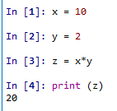
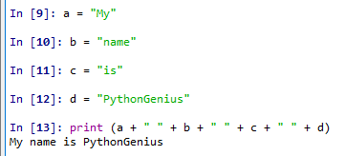
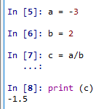
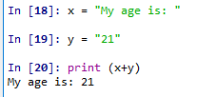
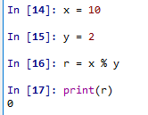
PRIMITIVE DATA TYPE - Answer
1.
2.
3.
NOTE: https://www.w3schools.com/python/python_operators.asp
4.
NOTE: Anything between quotes are string.
That includes space “ “, symbols “^%$#@$#@” ,
and even empty string “” .
5.
NOTE: You can only concatenate string (str) object with string(str). Not str with any number including integer (int). Digits between quotes are still string.
e.g. “123” is a string.

Slide 5
II. Collections
Collection in Python denotes collection of zero or more elements.
Collection is iterable, this means, you can iterate through each elements.
Samples:
- empty collection
e.g. []
- word is collection of letters
e.g. [“C”,”A”,”T”,”D”,”O”,”G”]
- Rows / columns in excel are collection.
Numbers = [1,2,3] # collection of numbers
Name = [‘Bob’,’Teddy’,’Sandra’] # collection of words
Profession = [‘Programmer’,’Tree Hugger’,’Data Scientist’]
Rows = [ [1, ’Bob’, 32, ‘Programmer’], # collection of collection
[2, ‘Teddy’, 34, ‘Tree Hugger’],
[3, ‘Sandra’, 31, ‘Data Scientist’] ]
TYPES of collections:
List - collection of any elements.
Adding element to a list. E.g. Adding 5 to the list.
Get element(s) from a list.
NOTE: Any collection with index starts with position ZERO (0).
To get the first element of the list x will be :
x[0]
x = [1,2,3,4] | x = [True,True,False]
x = ['a','b','c','asd'] | x =[None, None]
x = [1,2,3,4]
x.append(5)
x[0] | Get the first element
x[1:3] | Get the 2nd (inclusive) to 4th (exclusive) elements
x[:3] | Get the 1st until 3rd (exclusive) elements
x.pop() | Get the last element
No. | Name | Age | Profession
1 | Bob | 32 | Programmer
2 | Teddy | 34 | Tree Hugger
3 | Sandra | 31 | Data Scientist

Slide 6
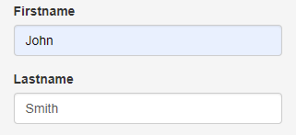

II. Collections
2. Set – collection of unique elements. There is no duplicate in a set.
Two ways to create set:
1) 2)
Add 4 to a set Remove ‘a’ from a set
List vs set:
3. Dictionary - collection of KEY , VALUE lookup.
Consider the typical form.
KEY
VALUE
This can be represented in dictionary:
To get the value of they key “Firstname” :
s = {1,2,3}
x = [4,5,6,6]
setX = set(x)
s.add(4)
s = {'a','b'}
s.remove('a')
List | 1 | 1 | 2 | 3 | 4 | 4 | 5
Set | 1 | 2 | 3 | 4 | 5
Note:
You can use len() function to get the length of the collection. e.g. len([1,2,3]) , len({“a”:1,”b”:2})
https://www.w3schools.com/python/python_lists.asp
https://www.w3schools.com/python/python_sets.asp
https://www.w3schools.com/python/python_dictionaries.asp

Slide 7
II. Collections - Exercise
Create a list that contains different data types.
From the list in Q1, get the last element.
From the list in Q1, get the last 2 elements.
Find the unique elements of [1,1,2,3,4]
Create a dictionary containing price of the fruits:
Apple = 1 , Orange = 2 , Grape = 3
From the dictionary from Q5, get the price for Orange.
**FLIP TO NEXT SLIDE FOR ANSWER

Slide 8

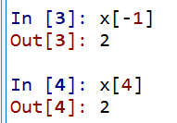

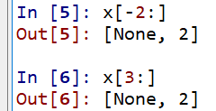

II. Collections - Exercise
1.
2.
3.
4.
5.
6.

Slide 9
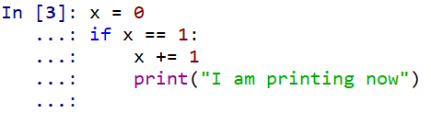
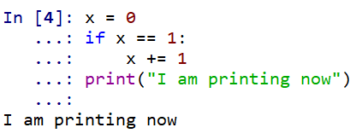

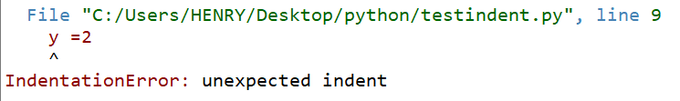
Few Gotchas to watch out for
1. Python is case sensitive.
e.g. camel is not the same as Camel.
2. Name a variable with the best description of what value it store.
e.g. myMoney=100 is better to describe the amount of money I have compared to x=100.
3. Indentation will determine the flow of the code. Use TAB for best programming habit.
e.g. in #3 below, print function will only run if x is equal to 1 because it is indented 1 tab to the right of the if.
while #4, will run the print function because it is on the same indentation as the if.
Improper indentation can even cause code error.

Slide 10
III. Control Statements - Operator
Operators are used to perform operations on variables and values.
Comparison operators Logical operators Identity operators
Membership operators
more…
https://www.w3schools.com/python/python_operators.asp
Symbol | Name | Sample
== | Equal to | 1 == 1
!= | Not Equal to | "a" != "abc"
> | Greater than | 5 > 1
< | Lesser than | 1 < 2
>= | Greater equal than | 2 >= 2
 |  | 2 >= 1
<= | Lesser equal than | 5 <= 5
 |  | 5 <= 6
Keywords
and
or
not
Keywords
is
is not
Keywords
in
not in

Slide 11
III. Control Statements – if – elif – else
If / elif / else statement can be used to control the flow of the program.
Consider the below
English statement: Pseudocode: Code:
It is 2 o’clock now. If it is 1 o’clock, go to lunch. Otherwise if it is 3 o’clock get some tea. Otherwise keep working.
It is 2 o’clock now. If now is 1 o’clock,
go to lunch
Else if now is 3 o’clock,
get some tea
Otherwise
keep working
now = 2
if now == 1:
print (“go to lunch”)
elif now == 3:
print (“get some tea”)
else:
print (“keep working”)
Pseudocode is an informal way of programming description that does not require any strict programming language syntax. It is used for creating an outline or a rough draft of a program.
Note that colon (:) is used after every condition any code on under (:) with the same indentation is considered to be in the same code block and executed together.
https://www.w3schools.com/python/python_conditions.asp

Slide 12
III. Control Statements – Exercise (use the code editor)
Write down the following statements into pseudocode and code.
If money is more than 10, print “buy a car”, decrease money by 9.
Otherwise If money is between 5 to 10, print “buy a bicycle”, decrease money by 5.
Otherwise print “spend all on new shoes”, set money to 0.
If money is 0, print “I am now broke”. Otherwise “I need to save”.
Test the above if statement with different initial money. E.g. 12, 5, 3. Try another numbers and predict the outcome before running the program.
With starting money of $12, it should print:
“buy a car”
“I need to save”
With starting money of $5, it should print:
“buy a bicycle”
“I am now broke”
With starting money of $1, it should print:
“spend all on new shoes”
“I am now broke”
Write the code: If “fruit” in the list of “key”, “money”, “fruit” , then print “it exist !”
NOTE: “in” is a Python keyword to test whether a collection contain the specified element.

Slide 13
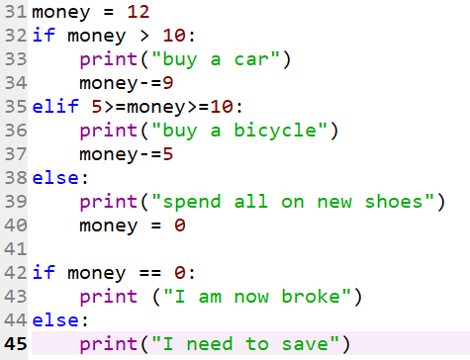
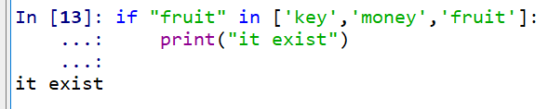
III. Control Statements - Answer
Pseudocode Code
Starting money = 12
If money > 10
print “buy a car”
decrease money by 9
Else if money >= 5 and money <= 10
print “buy bicycle”
decrease money by 5
Else
print “spend all on new shoes”
money = 0
If money is 0
print “I am now broke”
Else
print “I need to save”
IMPORTANT!
Keep a habit of writing pseudocode before writing the actual code. This will help to visualize more complex codes into more familiar language.
2.

Slide 14



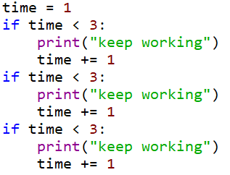
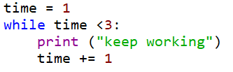
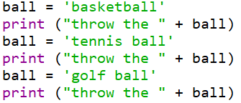
IV. Loop
Loop enable block of code to be repeated. There are two loops: for-loop and while-loop.
Refer to the link provided for the definition.
for loop: https://www.w3schools.com/python/python_for_loops.asp
e.g.
Given varieties of balls, print “throw the <ball>” using each of the balls.
Sample output:
Pseudocode
basket contains ['basketball','tennis ball','golf ball']
for each balls in the basket,
print "throw the ball“
Code with
for loop:
Code without for loop:
while loop: https://www.w3schools.com/python/python_while_loops.asp
e.g.
Now is 1 o’clock. Check every hour, if it is before 3 o’clock, print “keep working”. Sample output:
Pseudocode
Time is 1o’clock
While it is not yet 3 o’clock,
print keep working. Check the next hour.
Code with while loop: Code without while loop:

Slide 15
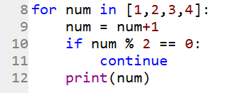
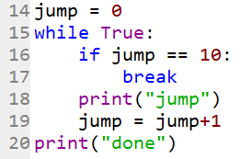
IV. Loop – Cont.
continue
This keyword can be used to skip the rest of the code in the block and continue with the next iteration.
E.g.
for each number in the list [1,2,3,4] , if number+1 is even number, continue (skip line 12 and start with next iteration on line 9). Otherwise, print the number.
break
This keyword can be used to exit the loop.
e.g.
“while True” will cause the code to run indefinitely.
The below code will print “jump” and increment the variable jump by 1 (line 18 and 19). Once jump is equal to 10, break, exit the loop to line 20.

Slide 16
IV. Loop – Exercise
1. Using for loop, count the sum of all numbers in the list.
2. Using while loop, count the sum of all numbers in the list.
3. Given a random string, print each letter. If it is a vowel, print “vowel”. If it is consonant, print the letter. If it is letter “e”, exit the loop.
Note that you can iterate through a string.
e.g. x = "daoigheaoigneao“
d
vowel
vowel
vowel
g
h
vowel

Slide 17

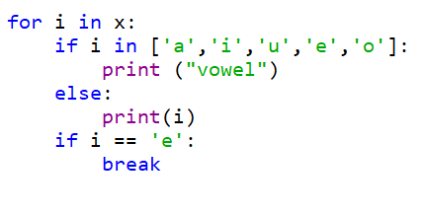
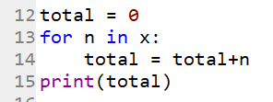
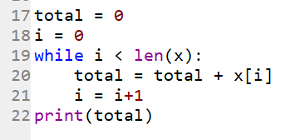
IV. Loop – Answer
x = [1,2,3,4,5,6]
1.
2.
3.

Slide 18
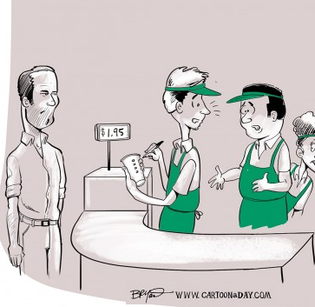
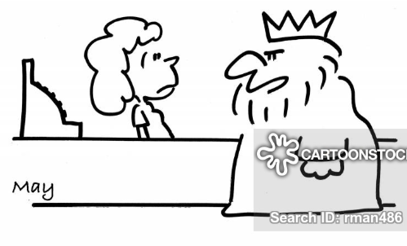
V. Function
I would like to order a cup, fill it with hot water, add coffee powder, wait two minutes, filter it, add some sugar and milk.
But sir, I have calculated everything correctly.
Except that you never return my change to me.
I think he is asking you to make_a_cup_of_coffee ()
Uhh.. what is that ?

Slide 19



V. Function
Function is a group of instruction(s). https://www.w3schools.com/python/python_functions.asp
e.g. This set of instructions can be replaced with make_a_cup_of_coffee()
Structure: e.g.
Note the return statement above. This is an optional keyword to return the result of the function to be used as part of another function. E.g.
Without return statement, Python will by default return None.
get a cup,
fill it with hot water,
add coffee powder,
wait two minutes,
filter it,
add some sugar and milk.
WARNING: print() is NOT the same as return

Slide 20



V. Function
NOTES:
1. Function need to be defined before used. This is done by using def .
2. Function arguments are optional. It is possible to define a function with no arguments such as:
def make_a_cup_of_coffee ()
3. You can have default value for a given argument. In below example, ‘number’ is mandatory, while ‘multiplyBy’ is optional with default value of 2.

Slide 21
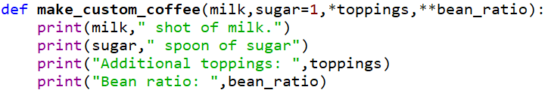
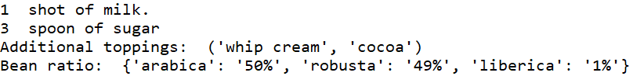
V. Function – cont.
Function can have arbitrary argument list. Denoted with *
Function can have arbitrary named arguments. Denoted with **.
Sample invocation:
Output:
NOTE:
The order of the arguments matter in the function definition. Start with mandatory argument, argument with default, *args, **kwargs.

Slide 22
V. Function - exercise
Create a function with 3 parameters (1 mandatory and 2 optional with default value) that will print and return the sum of all of the parameters.
Create a function that call another function.
Create a function that print anything that is passed to it.
Create a function that takes two equal length list, keys and values, and return a dictionary with each element of the keys mapped to each element of the values list.
Ensure that you test each function

Slide 23




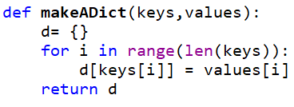


V. Function - answer
1.
2.
3.
4.

Slide 24
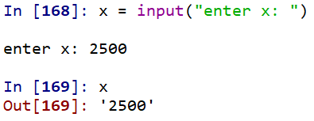
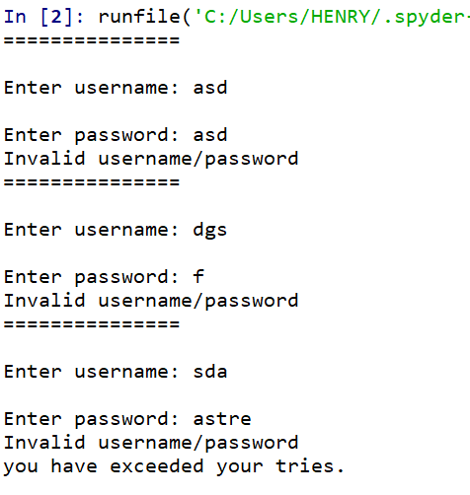
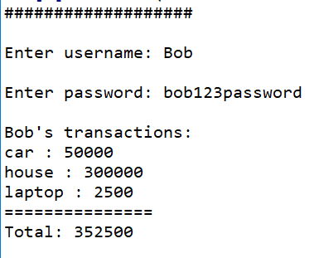
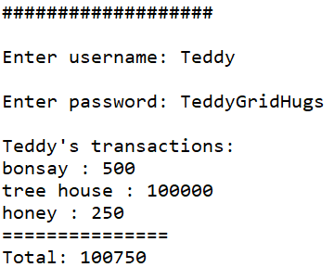
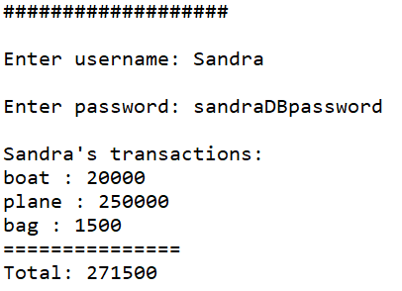
Project
Immitate a login process.
Create a dictionary containing username, password of users. Username as a key, password as value.
Ask the user for username , password up to 3 times before showing an error “you have exceeded your tries.” . You can use input() to get a user input.
If the login successful, show each of the user transaction and calculate the total. Use the appropriate collection to store all of the necessary transaction data of a given user.
If the login failed, show the error “Invalid username/password”.
Sample fail login: Sample successful login:

Slide 25
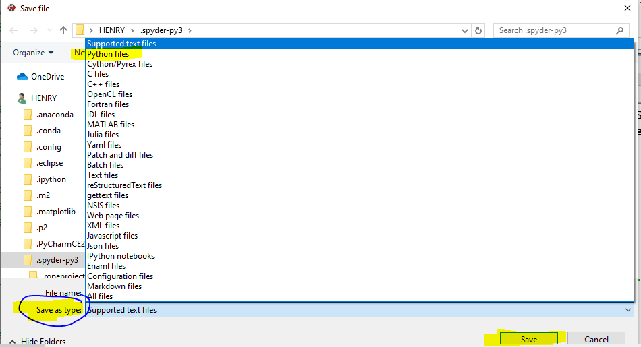
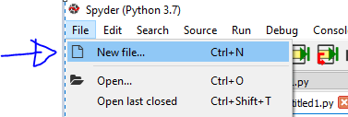
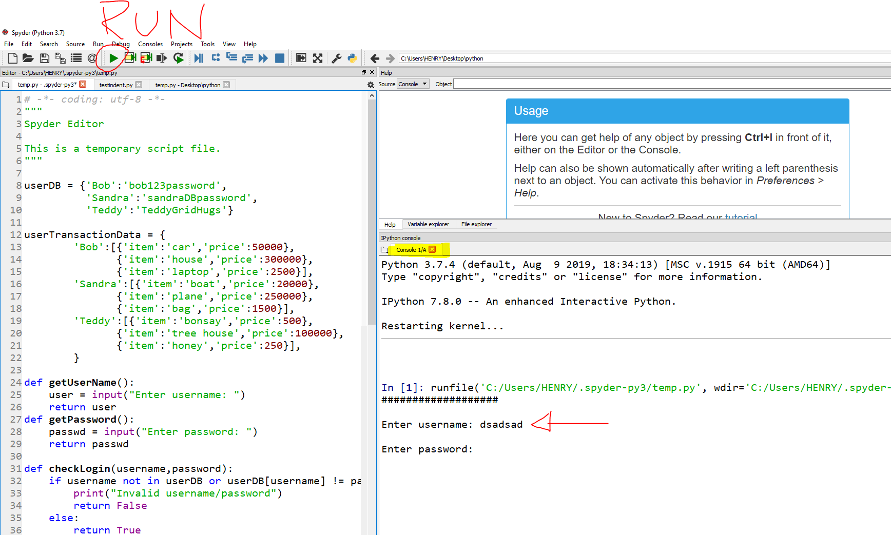
Project solution
In your IDE, create a new file.
Copy paste the codes below and save your file as python file.
Hit run and start playing at your console window.
userDB = {'Bob':'bob123password',
'Sandra':'sandraDBpassword',
'Teddy':'TeddyGridHugs'}
userTransactionData = {
'Bob':[{'item':'car','price':50000},
{'item':'house','price':300000},
{'item':'laptop','price':2500}],
'Sandra':[{'item':'boat','price':20000},
{'item':'plane','price':250000},
{'item':'bag','price':1500}],
'Teddy':[{'item':'bonsay','price':500},
{'item':'tree house','price':100000},
{'item':'honey','price':250}],
}
def getUserName():
user = input("Enter username: ")
return user
def getPassword():
passwd = input("Enter password: ")
return passwd
def checkLogin(username,password):
if username not in userDB or userDB[username] != password:
print("Invalid username/password")
return False
else:
return True
def getUserTransaction(user):
transaction = userTransactionData[user]
total = 0
print("\n%s's transactions:"%user)
for tran in transaction:
print("%s : %d"%(tran['item'], tran['price']))
total+= tran['price']
print("===============")
print("Total: " + str(total))
def main():
tries = 0
while tries < 3:
print("###################")
user = getUserName()
pwd = getPassword()
if checkLogin(user,pwd):
getUserTransaction(user)
break
else:
tries+=1
if tries == 3:
print("you have exceeded your tries.")
if __name__ == "__main__":
main()

